Slide 1


A MACHINE LEARNING and web development PROJECT ON
PREDICTING THE BIRTH WEIGHT OF A BABY.
PRESENTED BY-
Aman Dixit
Aaditya Pandey
Amrendra singh
Aman Tyagi

Slide 2

NEED??
Prediction of a birth weight in a normal range is an indicator for parents and doctors that baby is healthy a significance deviation from which can lead abnormality.

Slide 3
CHALLENGE
.
Our challenge is to predict the birth weight of Sammi Sternbach's baby. Sammi,
now, she is in her 41st week of pregnancy.
The birth weight of a baby can be predicted based on the external and internal factors associated with the mother and her environment.
Premature birth and low birth weight are the leading causes of increase in infant and neonatal mortality (death before 28 days of age) rates in the United States.
The low birth weight makes up 60-80% of the infant mortality rate.

Slide 4
IMPORTANCE OF BIRTH WEIGHT RELATED TO MORTALITY
The paradox states that LBW(low birth weight) babies do actually have mortality rate than normal babies.
It has been observed that mortality rate in condition of LBW of smoking mothers was less than those of non smoking .

Slide 5
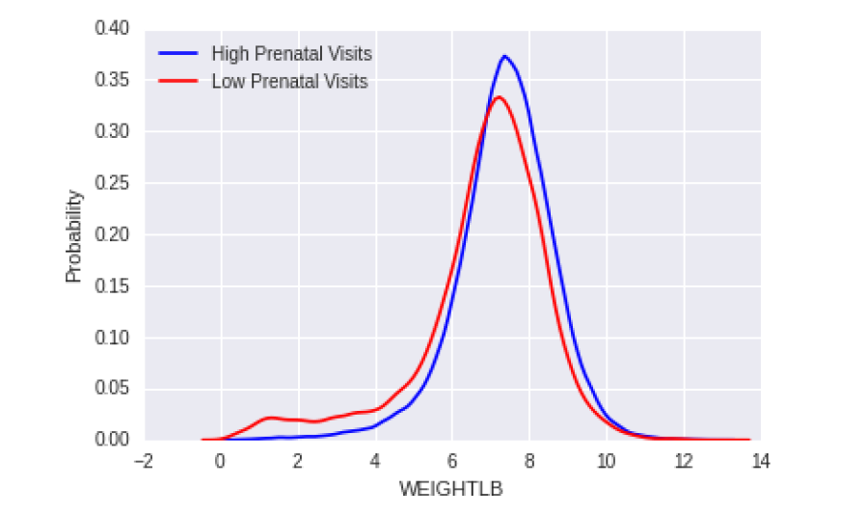
RELATION BETWEEN PARENTAL CARE AND BIRTH OF A BABY
It was observed that during the pregnancy the parental care plays a important role in the birth weight of a baby.
Parental care effects the decrease the birth weight of a baby from margin of 36 to 107 grams.

Slide 6
DATA MATRICE – The dataset that we have used here is taken from north Carolina mortality statiSTIcs 2008.
It contains 133422 cases for the year 2008 and similar data is available for the past 20 years across 125 variables. We used the following dataset for initial analysis and prediction. The following are some interesting variables observed in the dataset.
Race of Mother and Father
Sex of the Baby
Age of Mother

Slide 7
-Completed Weeks of Gestation -Month Prenatal Care Began - Locality - Plurality - Average # Cigarettes Used Daily - Average # Drinks Consumed Weekly - Medical History - Education of Parents - Apgar Score
Race of Mother And Father
We observed that Race plays an important role in the baby weight. There are
8 categories of races observed. They are Other Nonwhite, White, Black, Amer-
Ican Indian, Chinese, Japanese, Hawaiian ,Filipino and Other Asian or PacIFIC
Islander

Slide 8
CONDITIOND REMOVED FROM DATA SETS
post birth parameters that cannot be considered for prediction.
* Hospital Type Code
* Attendant
* Pounds of Birth weight
* Ounces of Birth weight
* Events of Labor
* Conditions of the Newborn

Slide 9
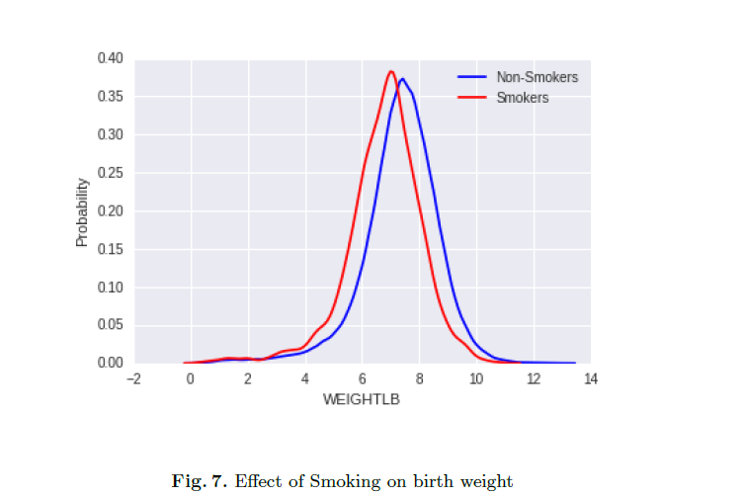
EFEECT OF SMOKING AND DRINKING ON BIRTH WEIGHT OF A BABY

Slide 10
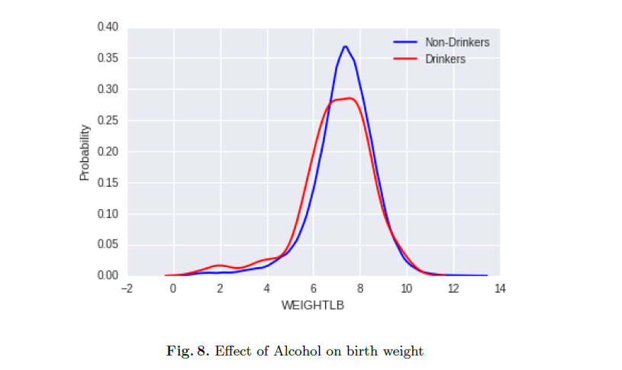
EFEECT OF SMOKING AND DRINKING ON BIRTH WEIGHT OF A BABY

Slide 11
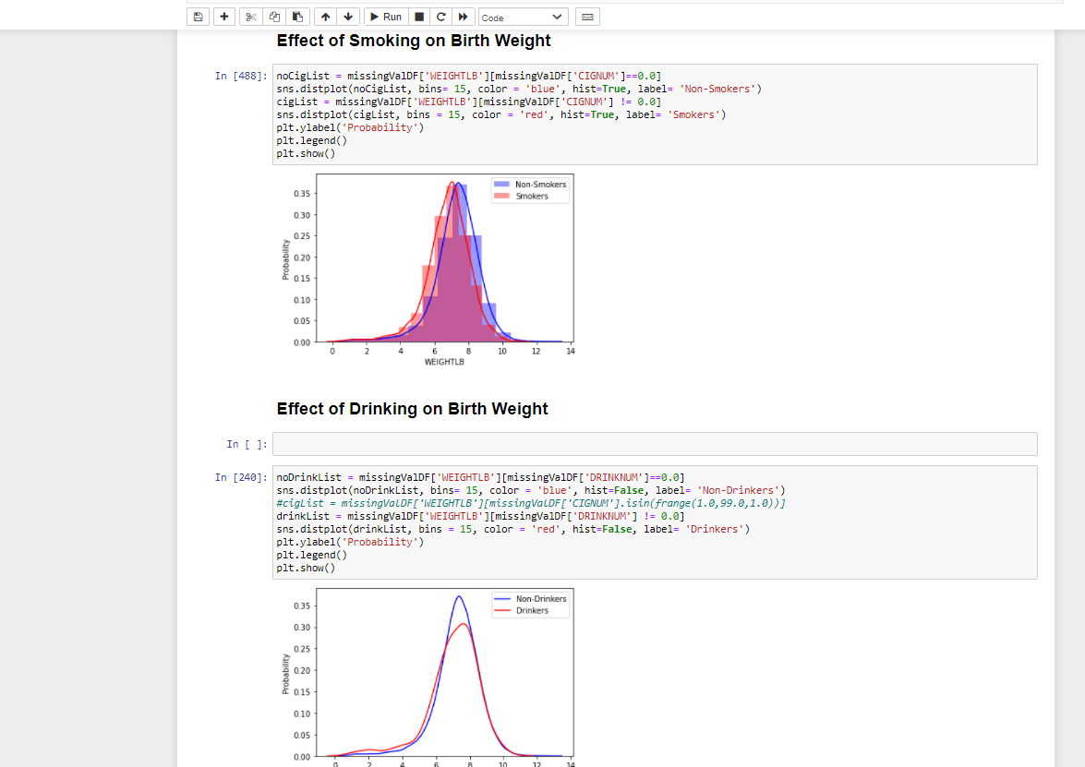
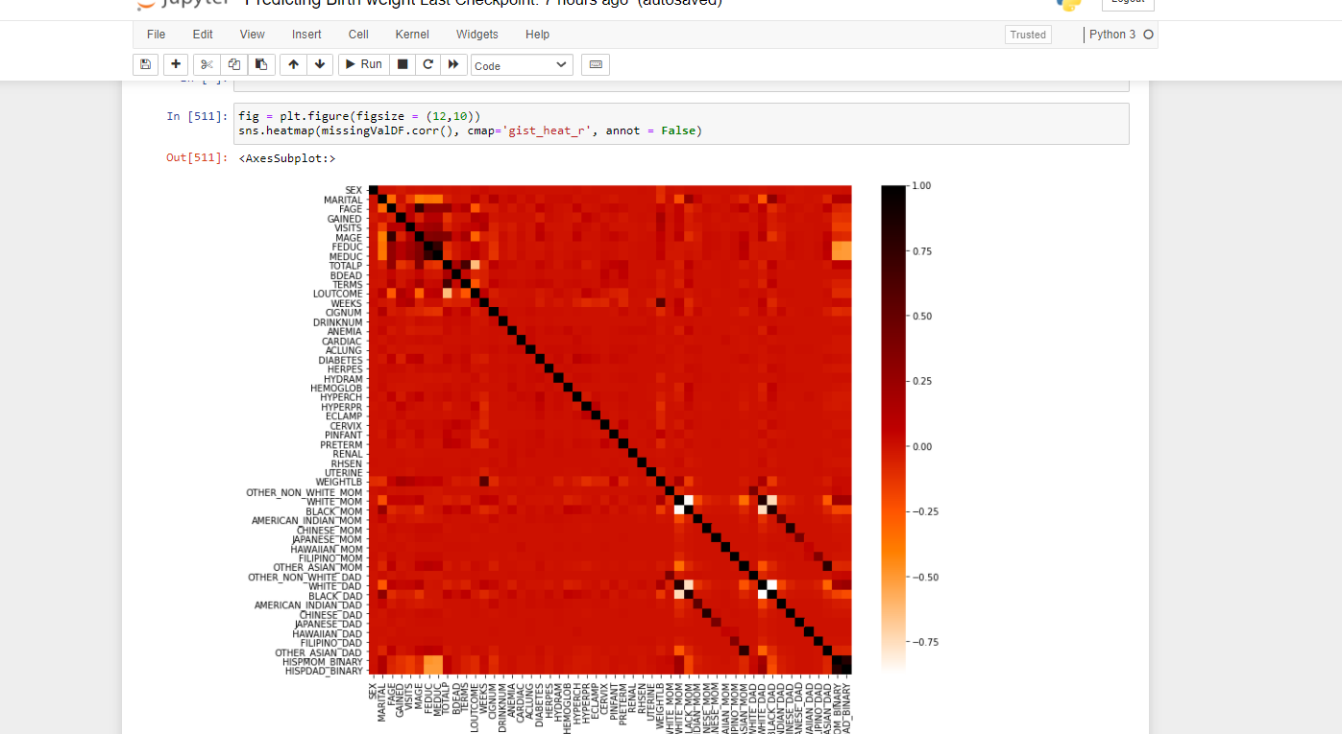
Data is explored visually with the help of seaborn library in Python

Slide 12
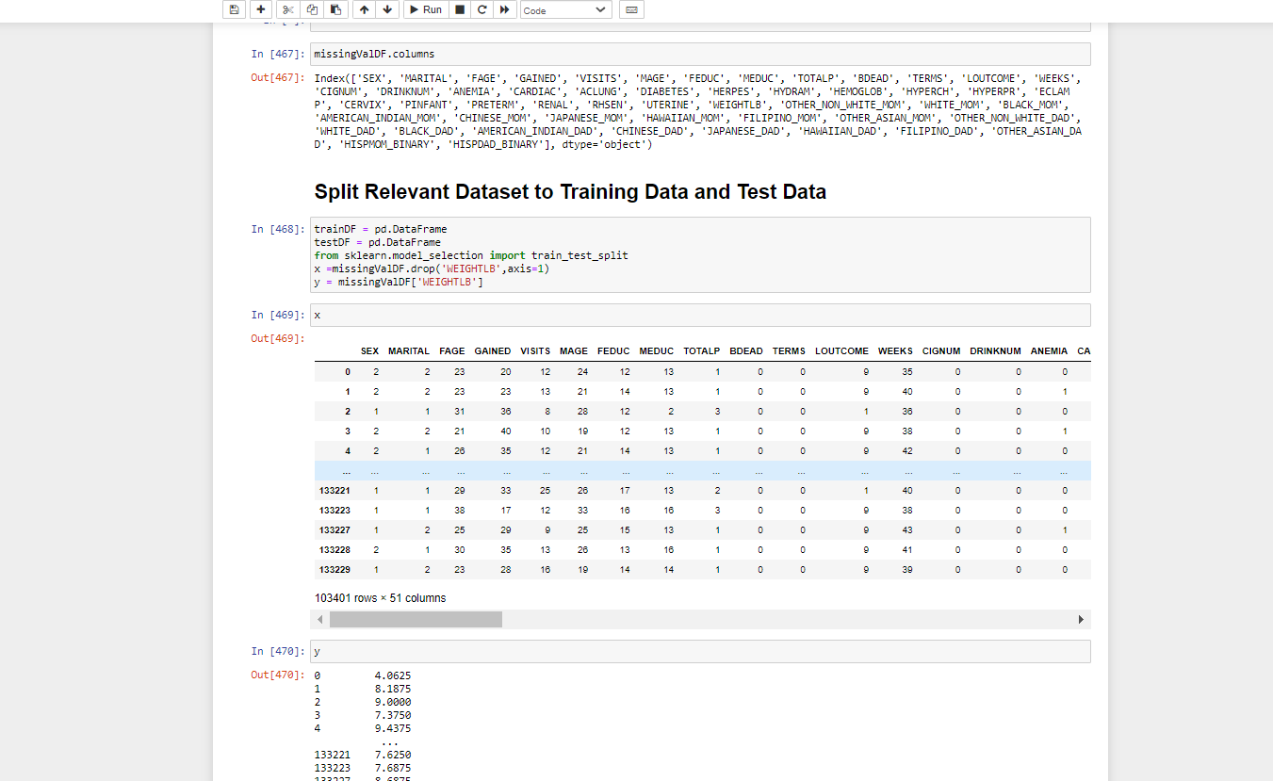
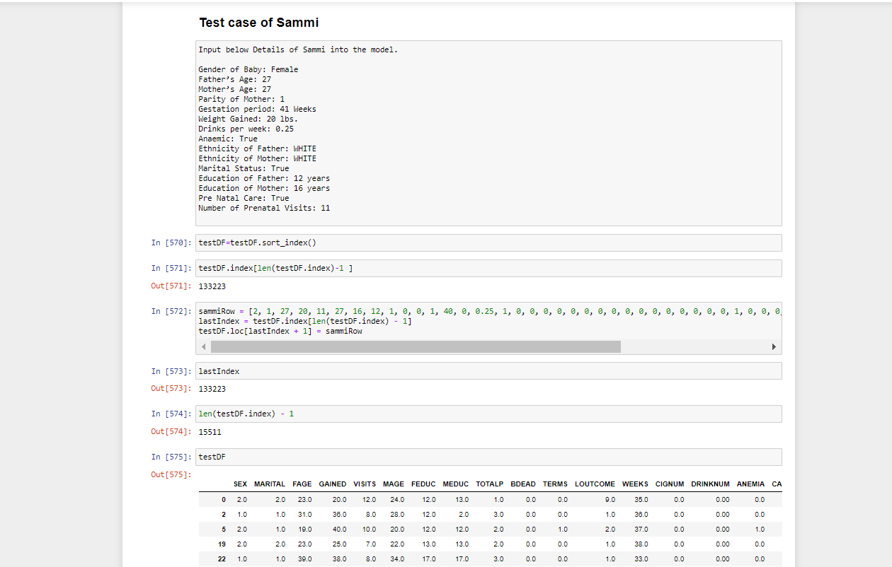
Our Data is then divided into Training and Testing set based on the selected features studied from previous steps.

Slide 13
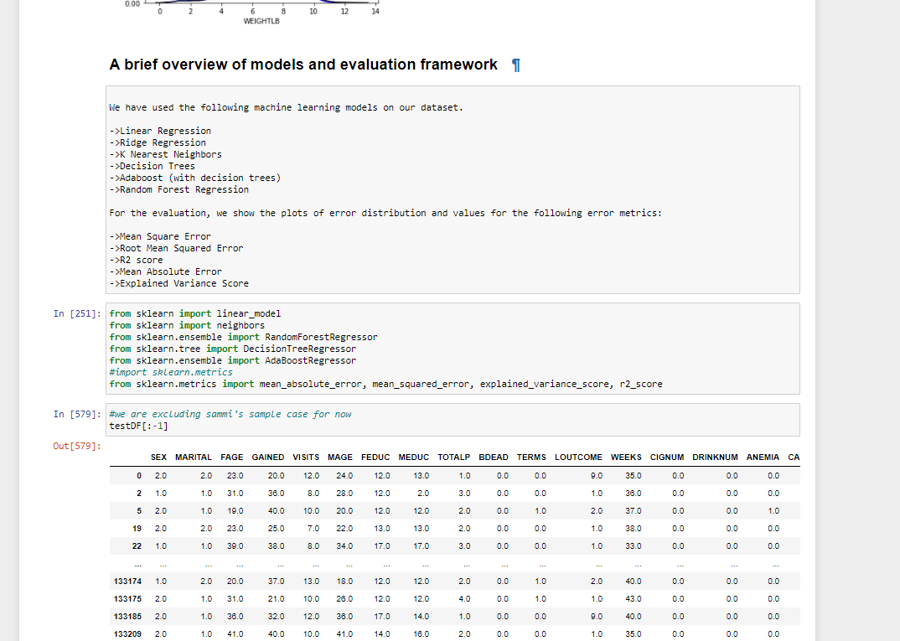
A brief overview of models and evaluation framework

Slide 14
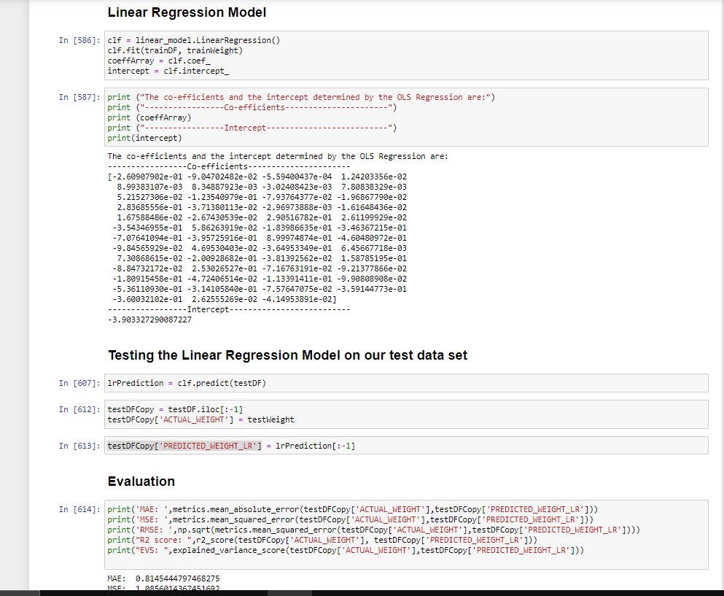
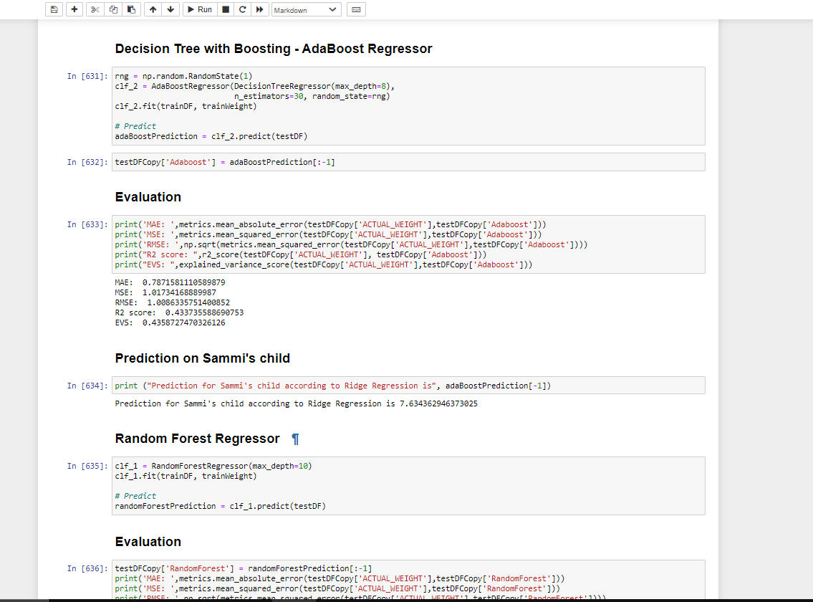
Few algorithms that we have applied:

Slide 15
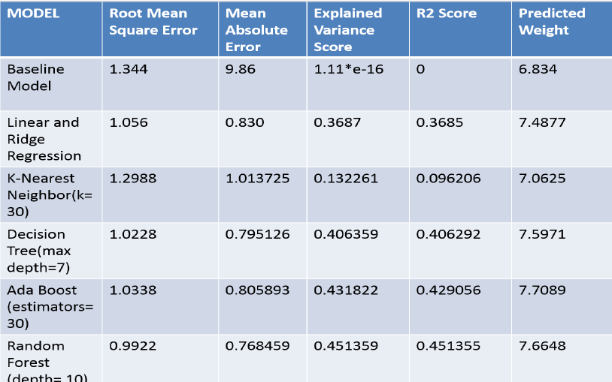
Mode selection

Slide 16
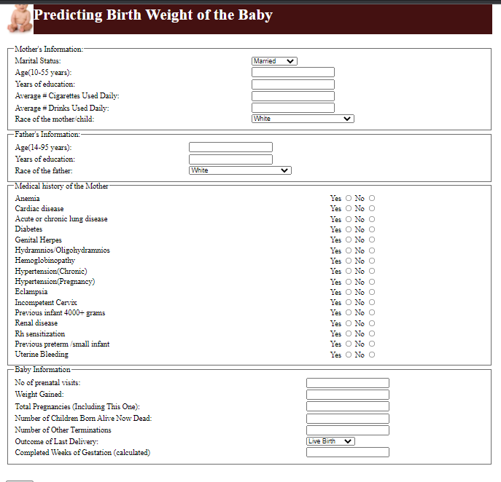
DEPLOYMENT OF THE MODEL

Slide 17
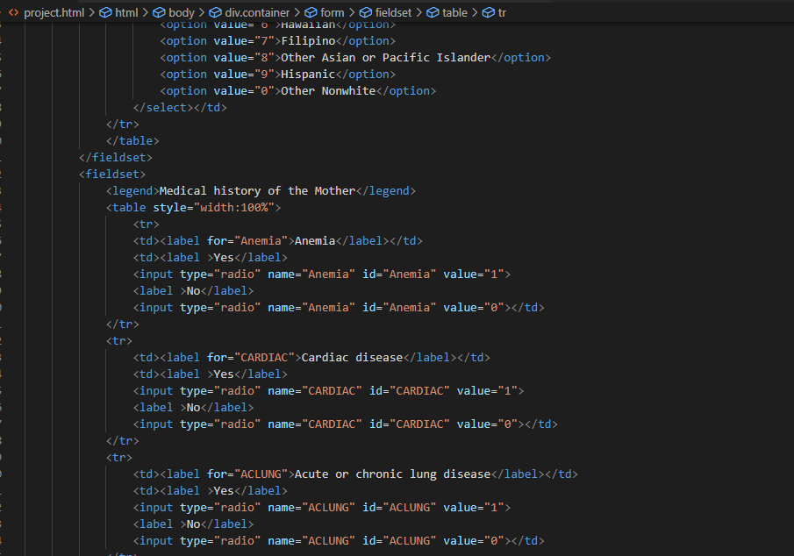
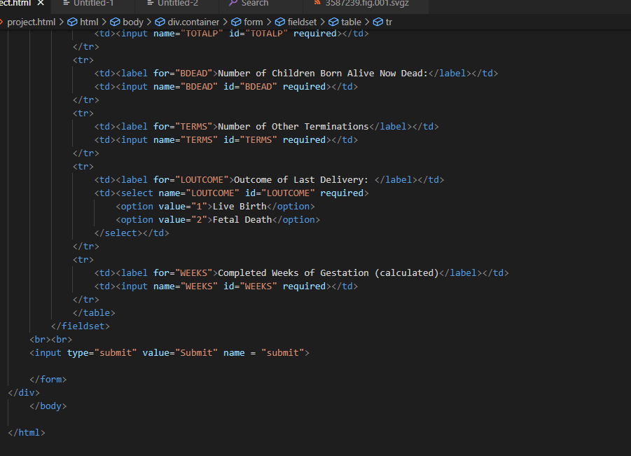
FRONT END CODE OF THE WEIGHT PREDICTOR

Slide 18
FINAL PREDICITION
Our prediction is made using the following details of Sammi. When we input
these values into our trained Random forest regressor we get the following prediction:
Gender of Baby: Female
Fathers Age: 27
Mothers Age: 27
Parity of Mother: 1

Slide 19
CONTINUED
Gestation period: 41 Weeks
Weight Gained: 20 lbs.
Drinks per week: 0.25
Anaemic : True
Ethnicity of Father: WHITE
Ethnicity of Mother: WHITE
Marital Status: True
Education of Father: 12 years
Education of Mother: 16 years
Pre Natal-Care : True

Slide 20
Bibliography
1. Wilcox, Allen J. "On the importance and the unimportance of birth- weight."International journal of epidemiology 30.6 (2001): 1233-1241
2. Nahum, Gerard G., and Harold Stanislaw. "Validation of a birth weight prediction equation based on maternal characteristics." The Journal of reproductive medicine 47.9 (2002): 752-760.
3. Nahum, Gerard G., and Harold Stanislaw. "Ultrasonographic prediction of term birth weight: how accurate is it?." American journal of obstetrics and gynecology 188.2 (2003): 566-574.

Slide 21
THE END
A SPECIAL THANKS TO ALL THE RESPECTED MENTORS AND TEACHERS FOR THEIR CONSTANT SUPPORT AND INSPIRTION.
Specially Shivangi Tyagi ma’am for coordinating us so wisely

